Slide 1
Treatment Utilization Before Suicide (TUBS)
*
Specific Aims:
  Identify the types/timing of defined diagnoses prior to suicide (cases only; hypothesis-driven).
  Compare defined diagnoses, visit types, demographics (case-control; hypothesis driven)
  Environment-wide association study (EWAS) to detect unknown diagnoses, procedures, visits, medications, and other clinical factors (case-control; hypothesis-generating)
  Develop a prediction model / algorithm for suicide in health systems including factors from Aims 1-3.

Slide 2
TUBS: Project Methods, Timeline
*
Identify all suicide cases and matched controls across 8 health systems, 2000-2014
  ~3,000 suicides across sites; 300,000 controls (1:100 ratio of cases to controls)
    Allows additional analysis of subgroup variation (e.g., variation in factors among adolescents)
  Matched on site and index date (date of death for cases).
  VDW data programs for data extraction developed by HFHS and distributed to all sites.
Second Year Timeline:
  Program 2 distributed; Data Collected Fall 2016
  Aim 2a analysis completed by February 2017

Slide 3
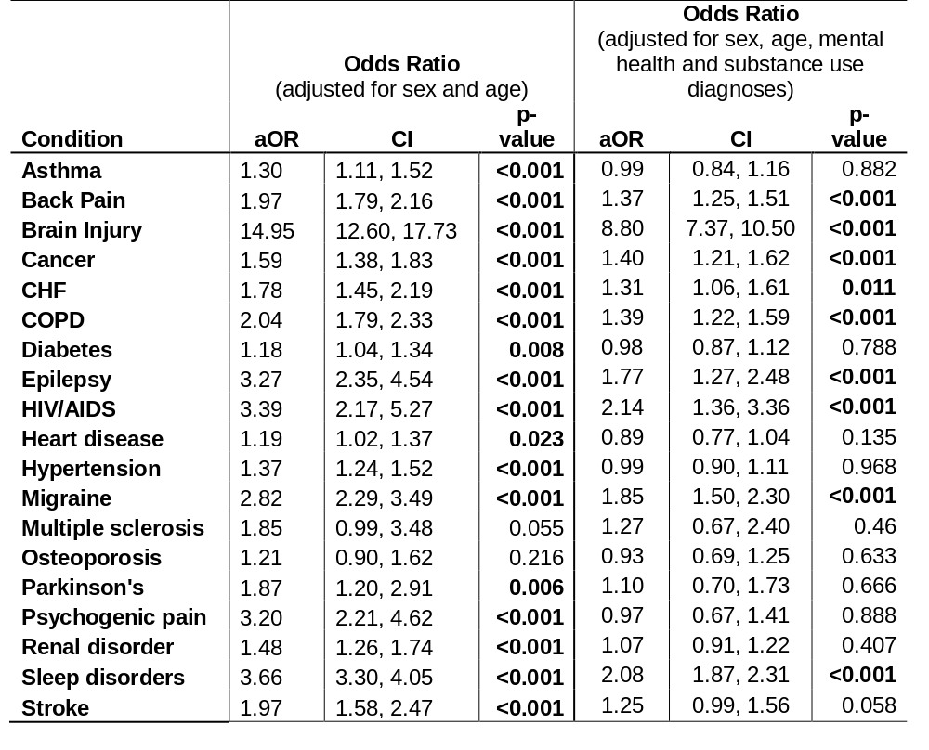
TUBS: Data from First Paper

Slide 4
TUBS: Data from First Paper
 | Controls (n=267,400) | Cases (n=2,674) | Odds Ratio (OR)* |  |  | Adjusted Odds Ratio (OR)* (adjusted for sex and age) |  |  | Adjusted Odds Ratio (aOR) (adjusted for sex, age, mental health and substance use diagnoses)
# of Conditions | % (n) | % (n) | OR | CI** | p-value | OR | CI** | p-value | aOR | CI** | p-value
0 | 64.0 (171044) | 38.3 (1024) | -- | -- | -- | -- | -- | -- | -- | -- | --
1 | 20.5 (54812) | 23.6 (630) | 1.92 | 1.74, 2.13 | <0.001 | 1.72 | 1.55, 1.91 | <0.001 | 1.20 | 1.08, 1.33 | <0.001
≥ 2 | 15.5 (41544) | 38.2 (1020) | 4.12 | 3.77, 4.50 | <0.001 | 3.11 | 2.80, 3.45 | <0.001 | 1.70 | 1.52, 1.89 | <0.001

Slide 5
MHRN Zero Suicide Grant
*
Co-PIs: Brian Ahmedani & Greg Simon
Sites: Henry Ford, Group Health, and Kaiser Permanente Systems in Colorado, Northwest, Northern California, and Southern California.
Specific Aims
  Collaborate with health system leaders to develop EHR metrics to measure specific quality improvement targets and care processes tailored to local NZSM implementation.
  Examine the fidelity of the specific NZSM care processes implemented in each system.
  Investigate suicide attempt and mortality outcomes within and across NZSM system models.

